Slide 1

Predicting Disneyland Review Sentiment
David Berberena

Slide 2
Background
In 1955, Walt and Roy Disney opened their first theme park in Anaheim, CA, and called it Disneyland
This legacy has grown to include the successful operation of six theme park resorts encompassing more than fifteen theme parks across three continents, many new franchises, and millions of guests enjoying Walt Disney’s dreams made a reality
These guests who vacation at Disney parks across the globe express their sentiments of gratitude, happiness, and fun, as well as annoyance, disbelief, and disappointment in the effort to have the Company better operate the theme parks

Slide 3
The Business Need
The Parks and Resorts sector of the Company has been facing recent customer retention issues due to many factors and business changes
Understanding the guests’ sentiments regarding their experience at Disneyland parks across the globe better positions the Company to be proactive rather than reactive to guest commentary
Predicting customer sentiment through their reviews will help the Walt Disney Company abate the recently waning attendance at their theme parks and strengthen the relationship between the Company and the guest

Slide 4
The Data
Variable Name | Description
Review_ID | The unique identifier attached to a guest for anonymity
Rating | An integer value of 1 (poor) through 5 (great) indicating a reviewer’s sentiment regarding their Disneyland park experience
Year_Month | The month and year in which the review was created
Reviewer_Location | The country where the reviewer resides
Review_Text | The review left by the reviewer which shares the most insight concerning the reviewer’s sentiment
Branch | The Disneyland park the reviewer made the review for (Disneyland California, Disneyland Paris, or Disneyland Hong Kong)

Slide 5
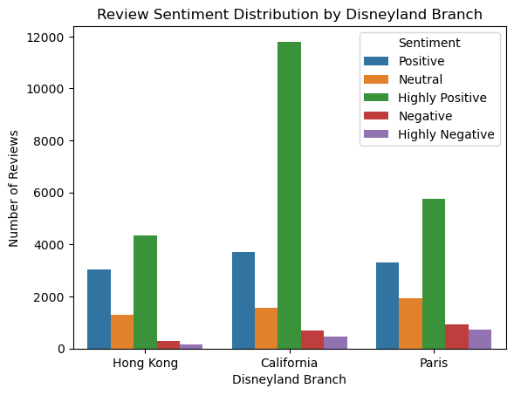
Bar Chart EDA

Slide 6
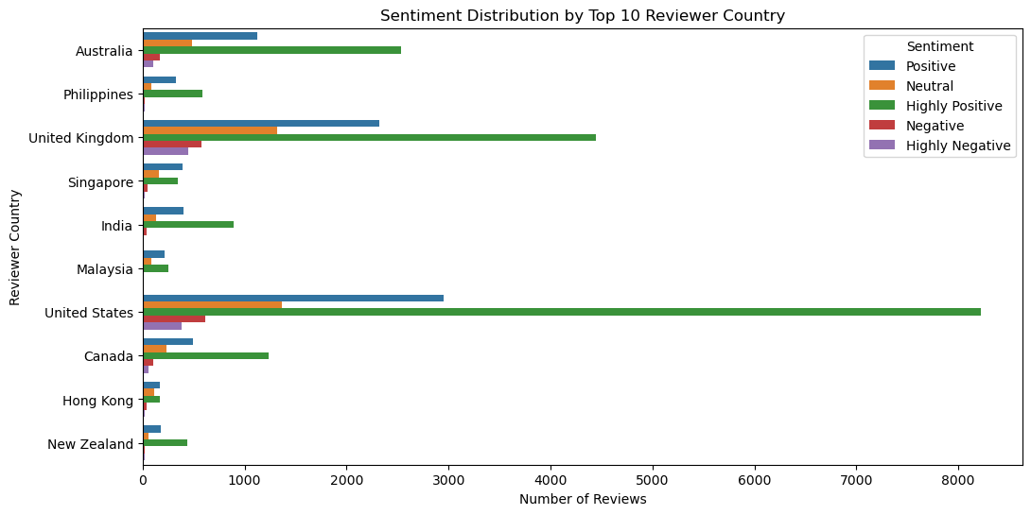
Bar Chart EDA

Slide 7
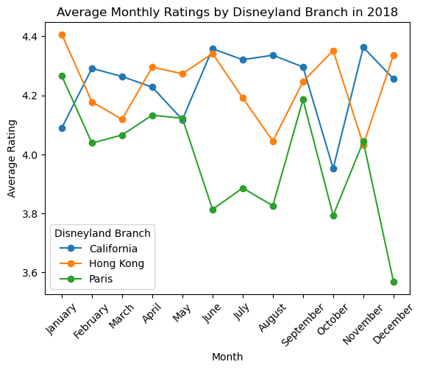
Line Chart EDA

Slide 8
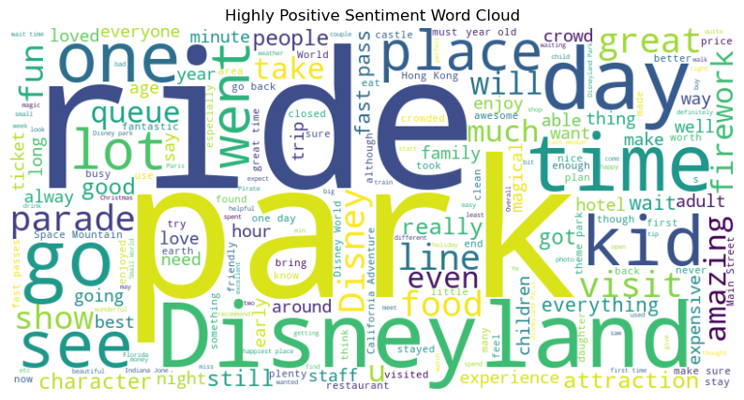
Word Cloud EDA

Slide 9
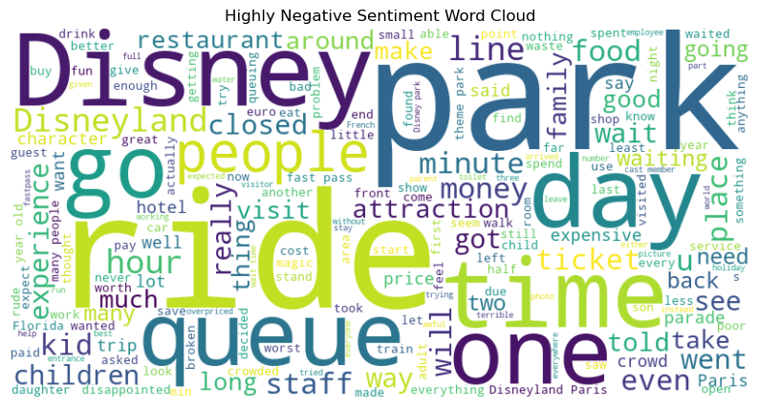
Word Cloud EDA

Slide 10
Data Preparation
Irrelevant variables were removed (Review_ID), features were split for ease of analysis (Year_Month), and useful features were added (Sentiment based on Rating variable)
Missing observations were dropped, columns were renamed (Branch), and the dataset’s features were reordered to present in a more readable way
A new sentiment column was added with the help of initial text sentiment analysis using TextBlob

Slide 11
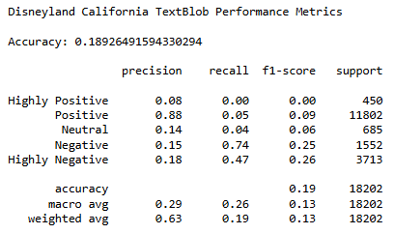
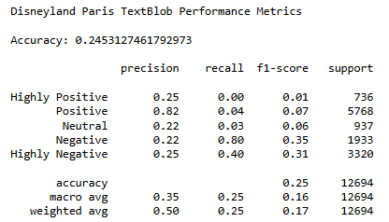
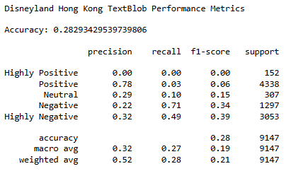
TextBlob Initial Sentiment Analysis
Using TextBlob’s sentiment polarity metric, new sentiment classes were made
The data was split into three sets (one for each Disneyland branch) and each was tested for predictive accuracy regarding the comparison between original sentiment classes and new ones

Slide 12
Textual Preprocessing
The review text was normalized with the conversion of the letters to lowercase, and special characters, punctuation, stopwords and unnecessary prefixes/suffixes were deleted
The Disneyland branch data subsets were split into training and test sets and were then subject to TF-IDF vectorization (turns the reviews into numerical values indicative of an aggregate of a word's importance relative to the entire review)

Slide 13
Modeling
Model 1: Logistic Regression (simple model to address class imbalance)
Model 2: Naïve Bayes (simple model with cross-validation)
Model 3: Random Forest Classifier (complex ensemble model with large computational needs)
Model 4: Extreme Gradient Boosting Classifier (complex ensemble model with built-in normalization)

Slide 14
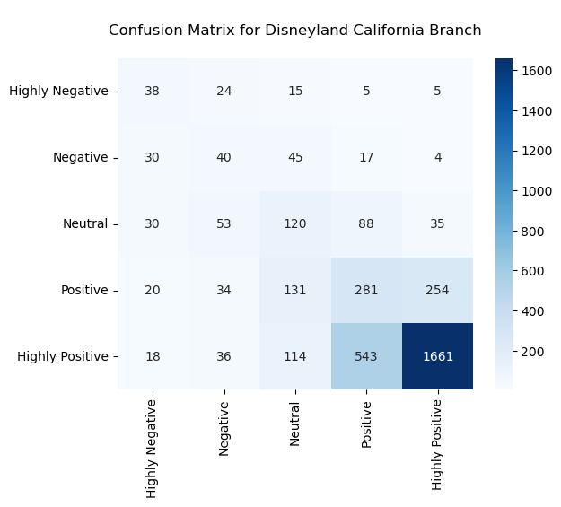
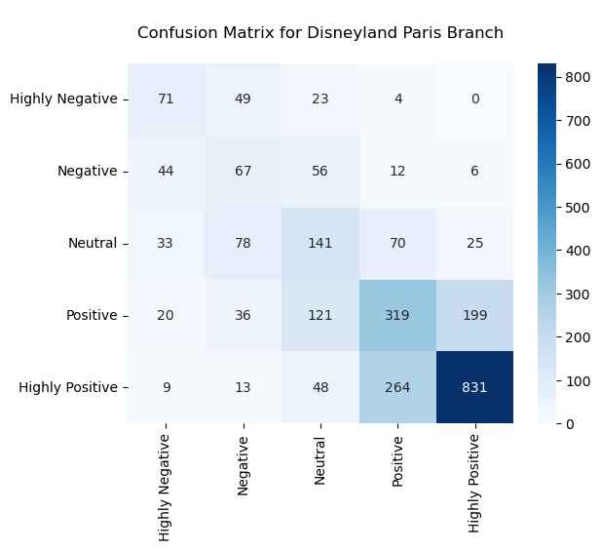
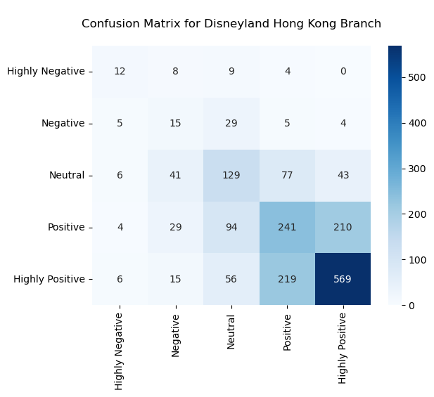
Logistic Regression
California: 58.78% accuracy Paris: 56.28% accuracy Hong Kong: 52.79% accuracy

Slide 15
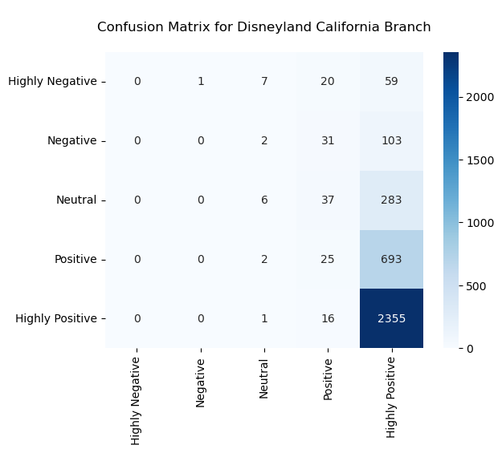
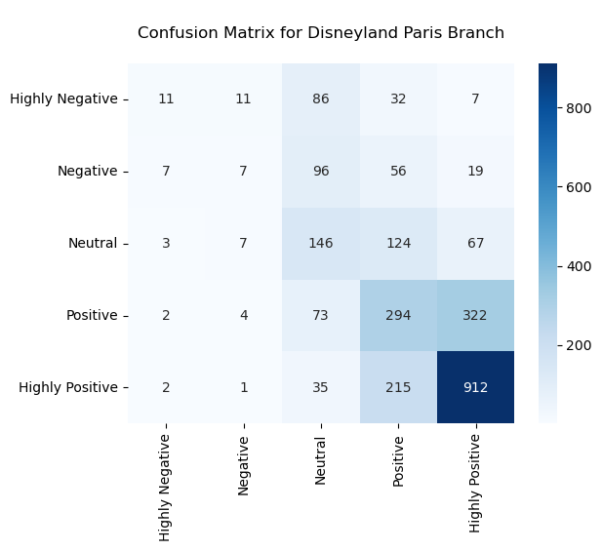
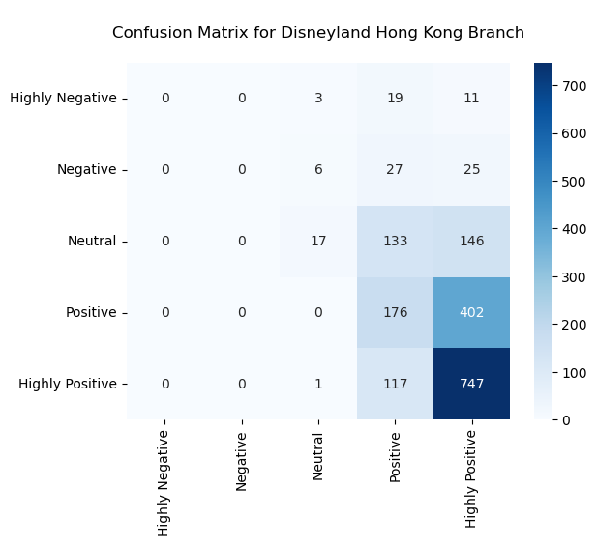
Naïve Bayes
California: 65.53% accuracy Paris: 53.96% accuracy Hong Kong: 51.37% accuracy

Slide 16

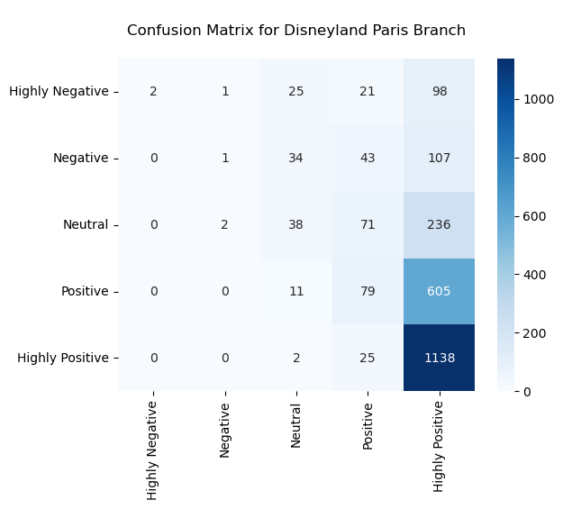
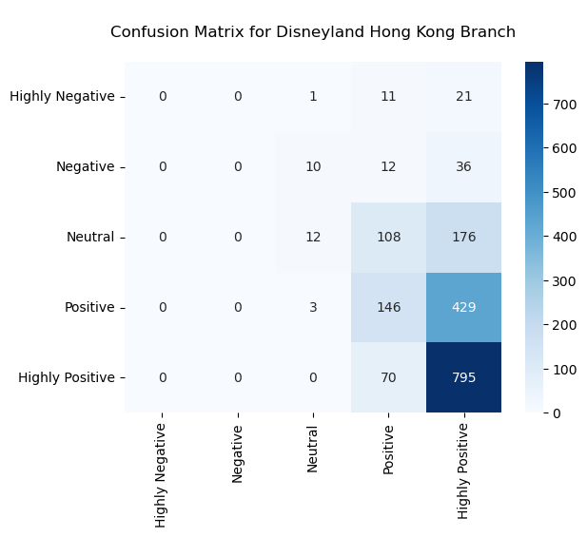
Random Forest
California: 65.31% accuracy Paris: 49.55% accuracy Hong Kong: 52.08% accuracy

Slide 17

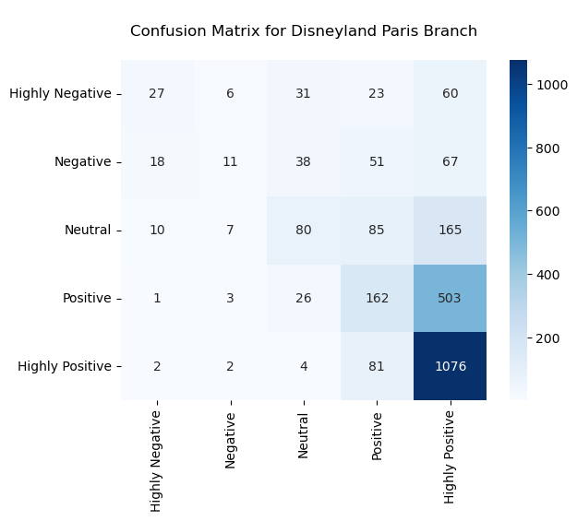

Extreme Gradient Boosting (XGB)
California: 66.03% accuracy Paris: 53.41% accuracy Hong Kong: 51.42% accuracy

Slide 18
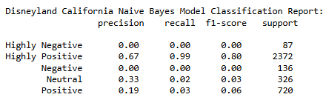
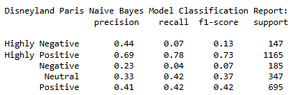
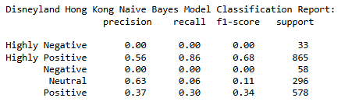
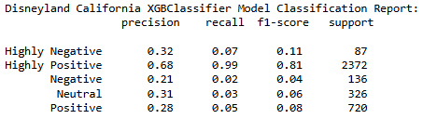
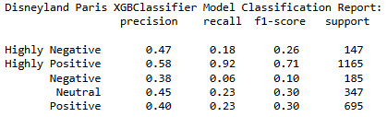
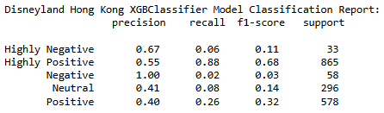
Results
As shown by the accuracy metrics for each Disneyland branch, the Naive Bayes models and the extreme gradient boosting classifier models are the best of the four models. Out of these two, the extreme gradient boosting models exhibit the better-performing classification reports as shown below, so we can declare this predictive model choice the best of the bunch

Slide 19
Future Recommendations
Techniques to potentially increase accuracy, precision, recall, and F-1 scores are as follows:
1. Run the previous predictive models using TextBlob's new review text sentiment values
2. Enforce more hyperparameter tuning techniques specific to the class imbalance
3. Incorporate class balancing methods by either duplicating the minority class values to equal the number of majority data points or dropping enough majority values to equal the number of the minority class values

Slide 20
Conclusions
Now that all the models have been crafted, it is clear that none of these predictive models are accurate enough to be considered for deployment
Each classification report printed has been lackluster in accurately predicting imbalanced class review sentiment. There are many ways to address this in the future to increase accuracy, however without more computational power and memory, it may take too long to process
The Walt Disney Company can benefit from the word cloud findings and tailor solutions to address the theme seen within them

Slide 21
Sources
1. Blogger, G. (2023, September 26). Top 5 Benefits of Sentiment Analysis for Businesses. Retrieved November 7, 2024, from https://determ.com/blog/top-5-benefits-of-sentiment-analysis-for-businesses/
2. Chillar, A. (2020, January 1). Disneyland Reviews. Retrieved November 7, 2024, from https://www.kaggle.com/datasets/arushchillar/disneyland-reviews

